Slide 1
Exception Handling

Slide 2
What is Exception?
An exception (or exceptional event) is a problem that arises during the execution of a program. When an Exception occurs the normal flow of the program is disrupted and the program/Application terminates abnormally, which is not recommended, therefore, these exceptions are to be handled.

Slide 3
Types of Exception
Checked exceptions − A checked exception is an exception that occurs at the compile time, these are also called as compile time exceptions. These exceptions cannot simply be ignored at the time of compilation, the programmer should take care of (handle) these exceptions.

Slide 4
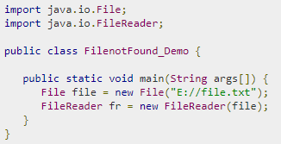
Example: Checked Exception

Slide 5
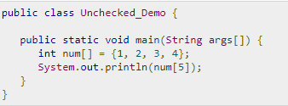
Unchecked Exception
Occurs at the time of execution. These are also called as Runtime Exceptions. These include programming bugs.

Slide 6
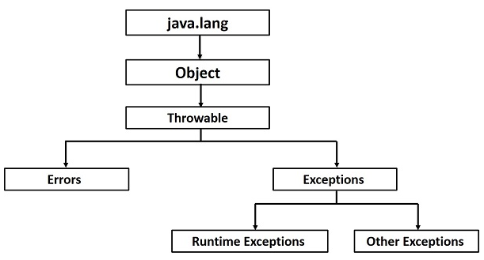

Slide 7
Error
Errors − These are not exceptions at all, but problems that arise beyond the control of the user or the programmer. Errors are typically ignored in your code because you can rarely do anything about an error. For example, if a stack overflow occurs, an error will arise. They are also ignored at the time of compilation.

Slide 8
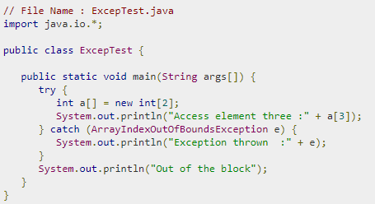
Lets start with..

Slide 9
The Throws/Throw Keywords
If a method does not handle a checked exception, the method must declare it using the throws keyword. The throws keyword appears at the end of a method's signature.
You can throw an exception, either a newly instantiated one or an exception that you just caught, by using the throw keyword.
Try to understand the difference between throws and throw keywords, throws is used to postpone the handling of a checked exception and throw is used to invoke an exception explicitly.

Slide 10
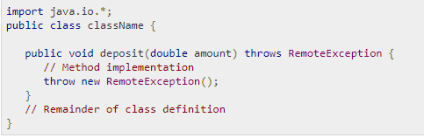
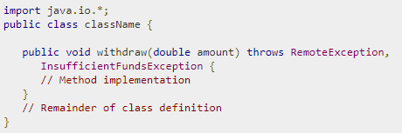
Contd..

Slide 11
The Finally Block
The finally block follows a try block or a catch block. A finally block of code always executes, irrespective of occurrence of an Exception.
Using a finally block allows you to run any clean up-type statements that you want to execute, no matter what happens in the protected code.
A finally block appears at the end of the catch blocks.

Slide 12
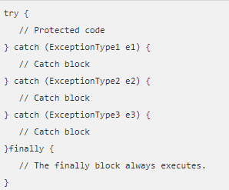
Syntax

Slide 13
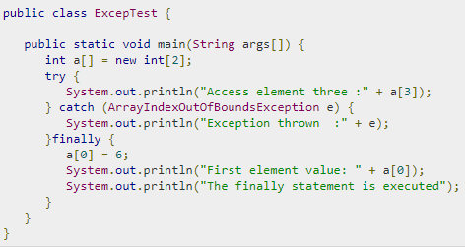
Contd..

Slide 14
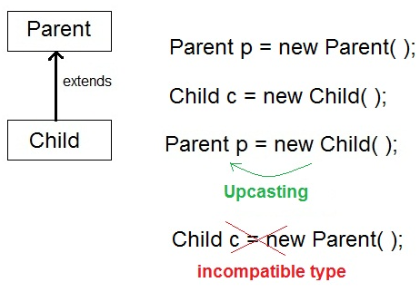
Runtime Polymorphism or Dynamic method dispatch
The type of object which it referred determines which version of overridden method will be called.
When Parent class
reference variable
refers to Child class
object, it is known as
Upcasting

Slide 15
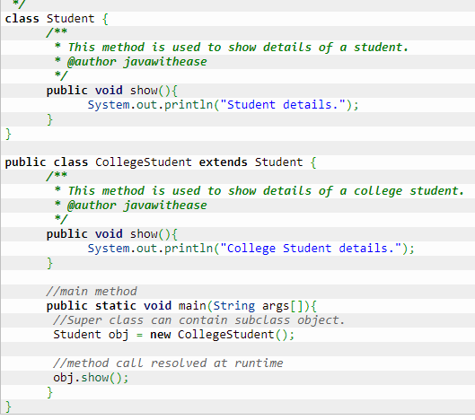
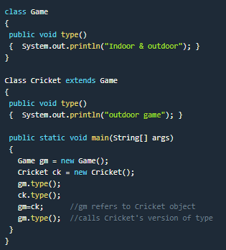
Example…

